Slide 1
A case for transparency: How HMDA informs policy
K. David Roell
3/11/2015

Slide 2
One dataset, multiple uses
Provide the citizens and public officials of the U.S. sufficient information:
to enable them to determine whether covered institutions are filling their obligations to serve the housing needs of the communities and neighborhoods in which they are located;
to assist public officials in distributing public sector investments in a manner designed to improve the private environment; and
to assist in identifying possible discriminatory lending patterns and enforcing antidiscrimination statutes.
HMDA’s legislative history reveals consistent Congressional intent to get more data to the public, sooner
Notes:
Provide the citizens and public officials of the U.S. sufficient information:
to enable them to determine whether covered institutions are filling their obligations to serve the housing needs of the communities and neighborhoods in which they are located;
to assist public officials in distributing public sector investments in a manner designed to improve the private environment; and
to assist in identifying possible discriminatory lending patterns and enforcing antidiscrimination statutes.
HMDA’s legislative history reveals consistent Congressional intent to get more data to the public, sooner
CRA data support
http://dsl.richmond.edu/holc_national/

Slide 3
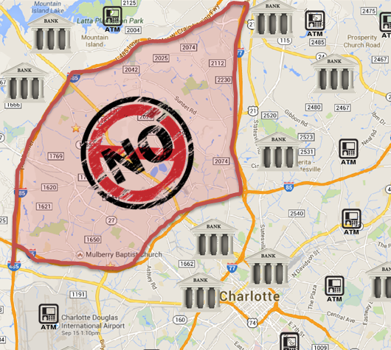
Data is great, but why collect it?
Urban Disinvestment
Redlining
Discrimination

Slide 4
HMDA’s microdata release
LAR: Loan Application Register
Annual release
39 public data fields
Aggregated data available at www.FFIEC.gov/HMDA
New data fields are coming, stay tuned!
The LAR data fields and definitions will be available 8/2015.
LAR datasets incorporating the new data fields will be published in 3/2018.
Notes:
LAR has 39 public data fields
49 after FFIEC combines with Census data (demographics and location)
The FFIEC first released microdata in 1991, believing “that release of the raw data files is consistent with the congressional intent to maximize the utilization of HMDA data.” Although there was no statutory obligation to consider applicant or borrower privacy, the regulators deleted three fields from the microdata released in order to protect privacy (the application or loan number, the date that the application was received, and the date action was taken).

Slide 5
Data processing
1) Tracts were grouped by minority population concentration for visualization
Tract Category | Minority population %
Low minority | <= 30%
Middle minority | 30.01 to 50%
Upper minority | 50.01 to 80%
High minority | >80%
2) Loans were split by minority status as determined by the FFIEC
1 = minority application/loan, 0 = non-minority application/loan
Notes:
Inputs to minority status are
applicant race fields (5), coapplicant race fields (5), applicantethnicity, coapplicantethnicity

Slide 6
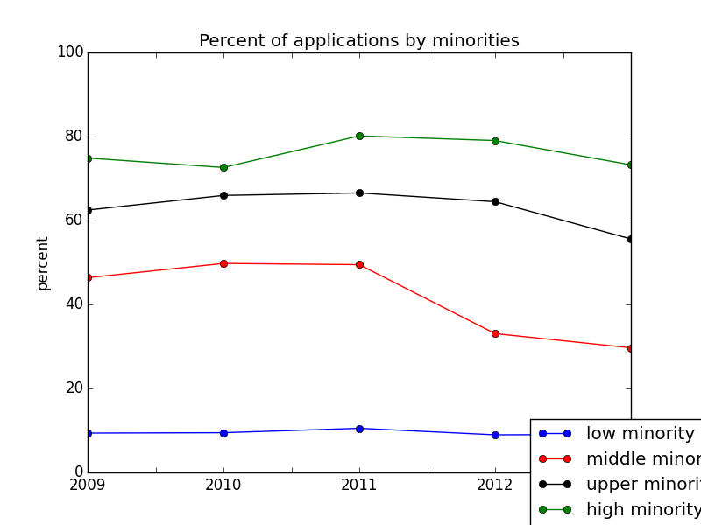
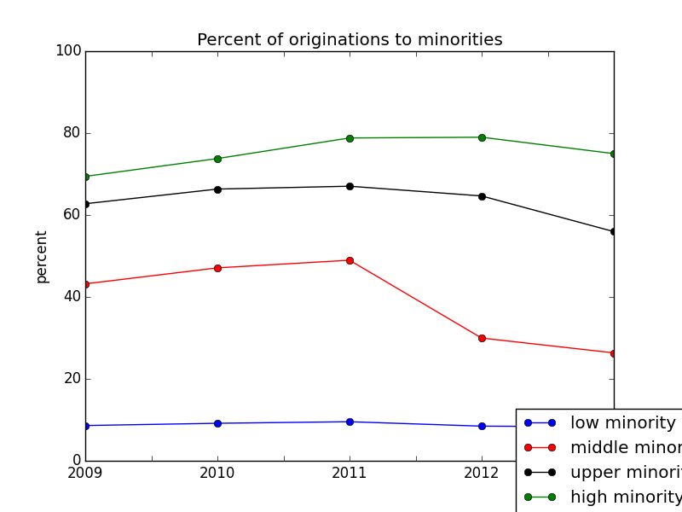
Declining market participation by minorities
Notes:
Decrease in share of minority applications and originations may reflect disparate economic impacts of the crisis
Application and origination share track each other, which indicates that approval processes are not biased against minorities
pre-application processes may be suspect

Slide 7
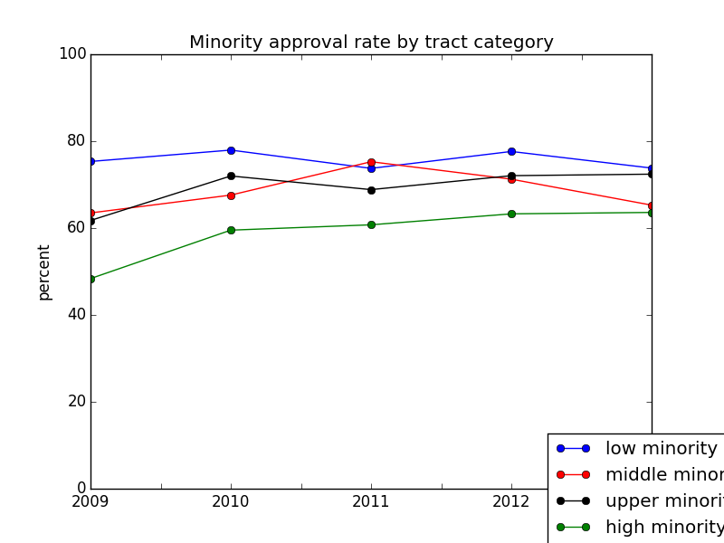
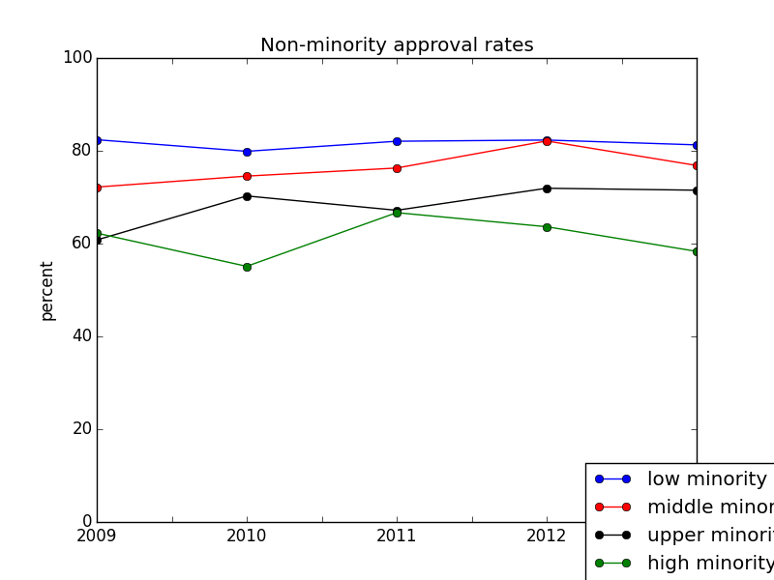
Approval rates scale by minority population concentration

Slide 8
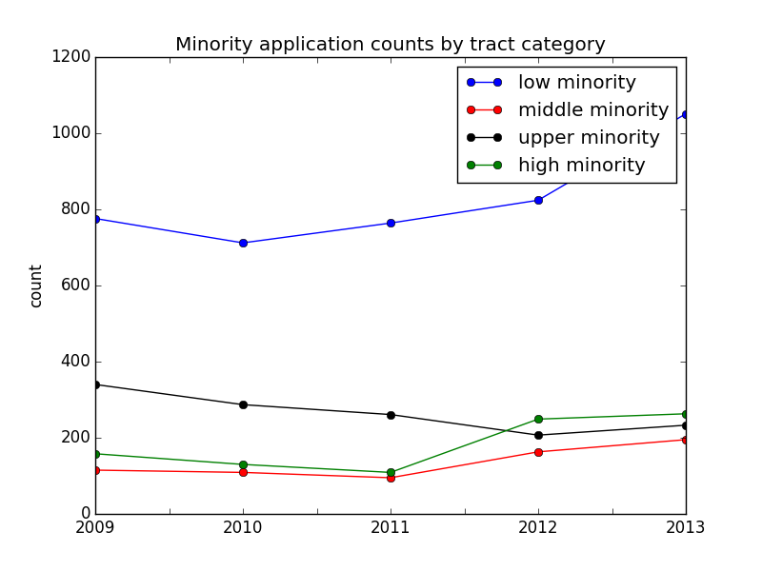
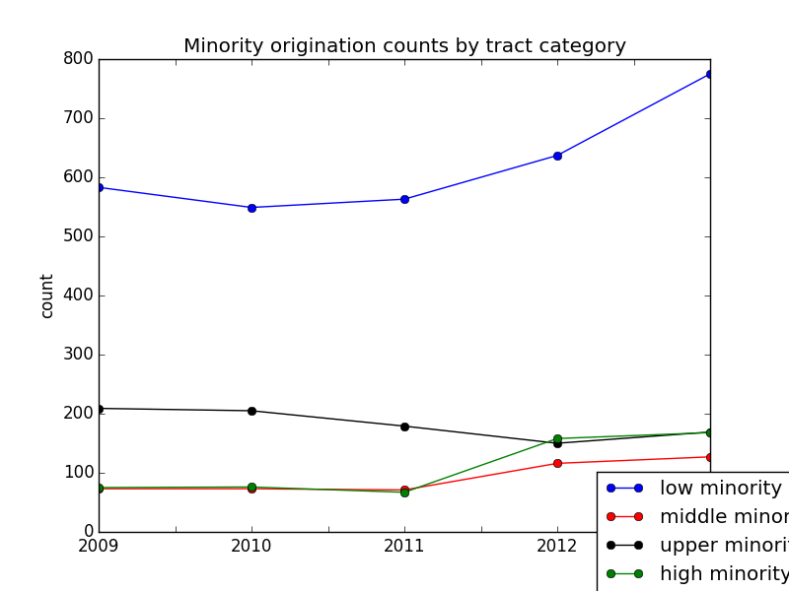
Communities with low minority populations recovered more quickly

Slide 9
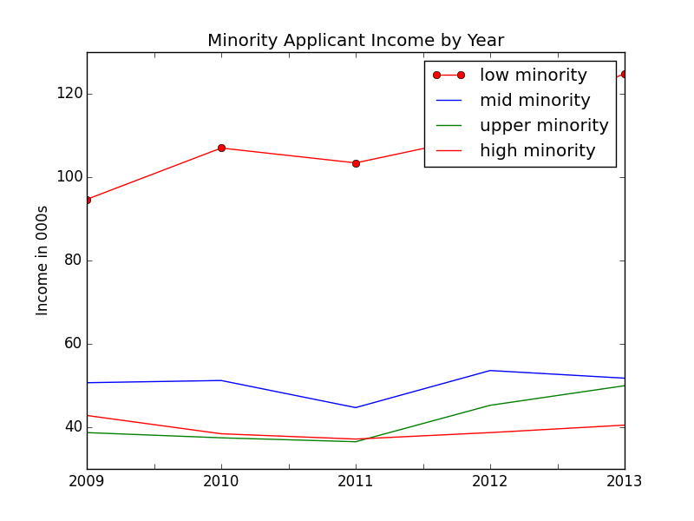
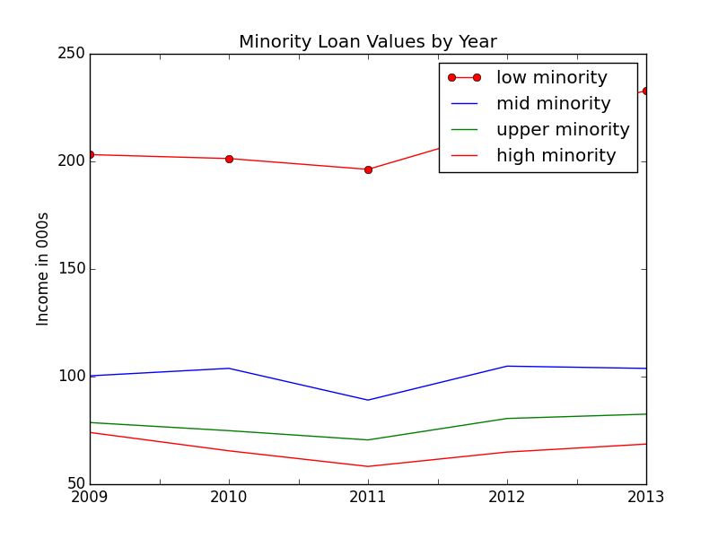
Loan values track income levels

Slide 10
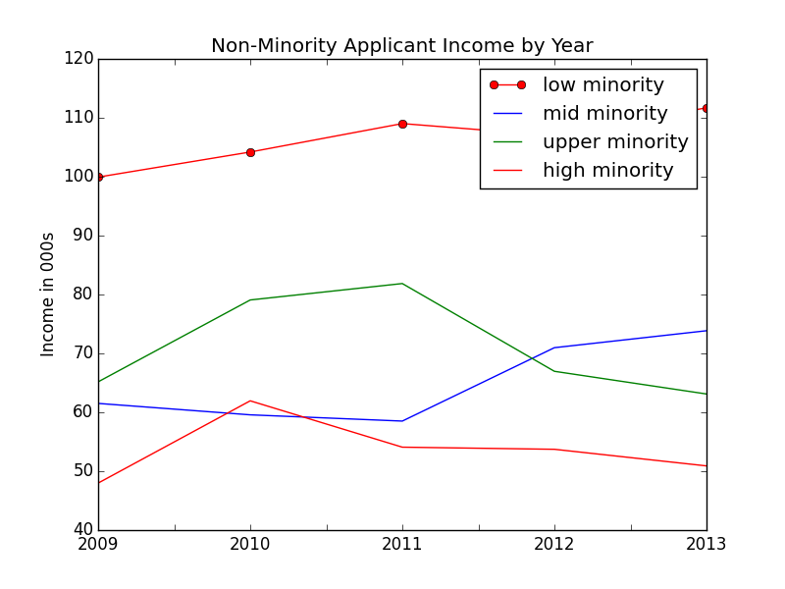
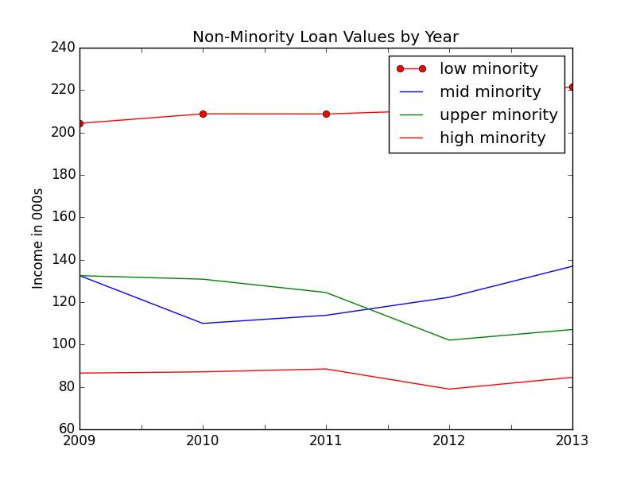
Disparate impacts are a result of economic exclusion

Slide 11
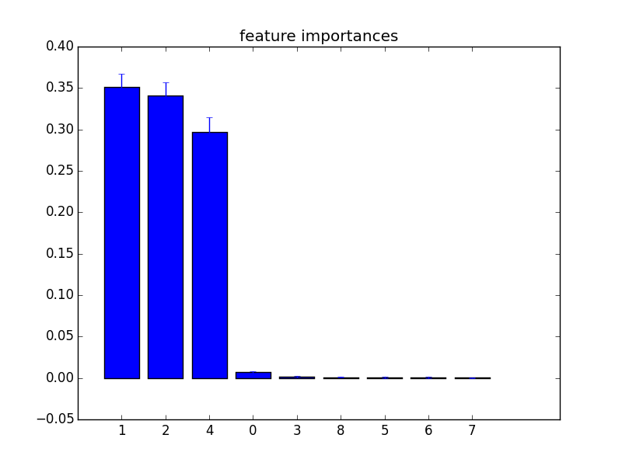
Feature importances indicate correlation among predictors
Applicant Income
Loan Amount
Minority population percent
Random forest AUC ~77%
New LAR data available 9/15

Slide 12
What is the shape of things to come?
Minority neighborhoods are still recovering from redlining effects from the 1930’s
Effects of the financial crisis were highly disparate
Policies must be crafted to reflect the vulnerabilities of specific neighborhoods
HMDA data intake, processing, and disclosure are being updated to monitor markets more effectively

